Slide 1
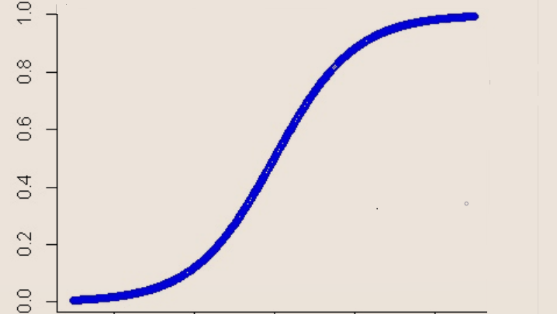
Logistic Regression
Ellen Lull
Machine Learning II
Presentation Links:
https://vimeo.com/532676244

Slide 2
Why Logistic Regression is used
Common Classification technique
Can be a building block of neural networks
We want to know if the dependent variable is 0 or 1 (binary).
Linear Regression cannot be used
May have multiple predictor variables
1 (True)
Independent Variable 1
Weight 1
Logistic Regression
Independent Variable 2
Weight 2
Weight n
0 (False)
Independent Variable n

Slide 3
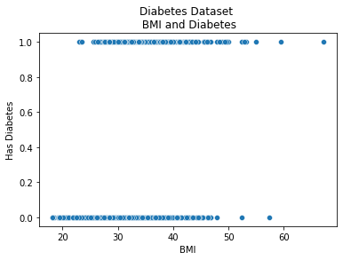
How Logistic Regression is Used
Sample data where Target (or Dependent) Variable is Binary.
Outcome is the probability of the dependent variable given the independent variables: P(Y|X)
We are trying to determine the estimation of the probability of Y given X.

Slide 4
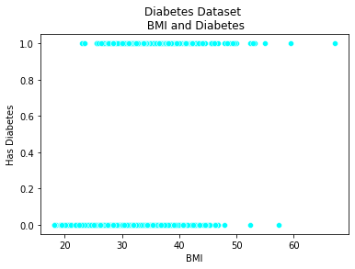
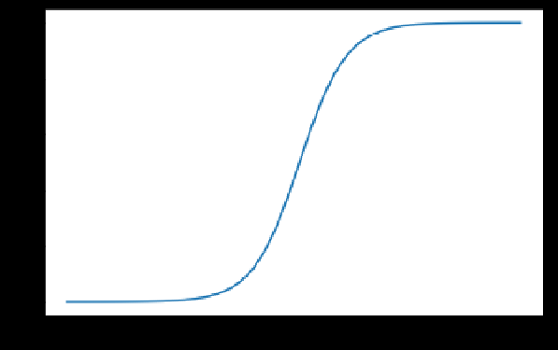
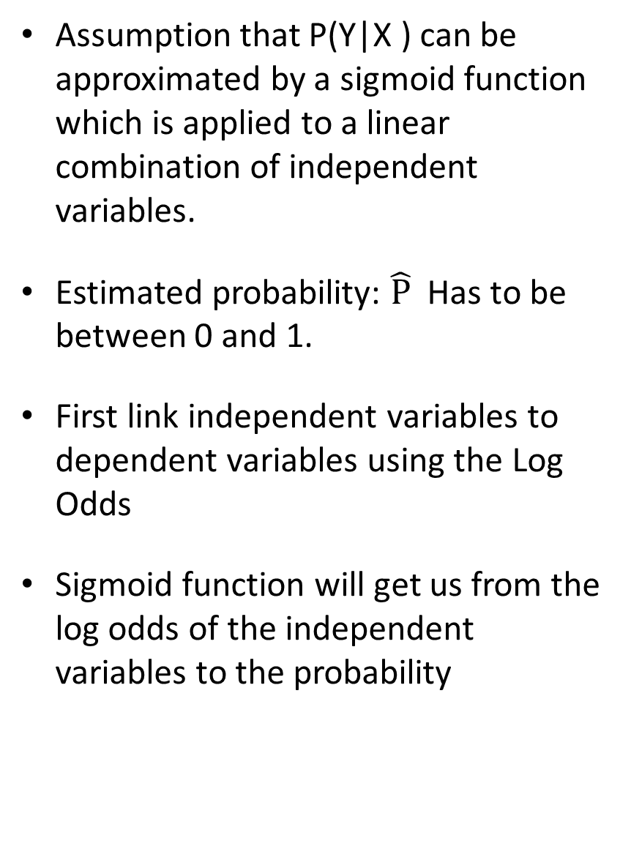
Logistic Regression Probability
Assumption that P(Y|X ) can be approximated by a sigmoid function which is applied to a linear combination of independent variables.
Estimated probability: $\hat{P}$ Has to be between 0 and 1.
First link independent variables to dependent variables using the Log Odds
Sigmoid function will get us from the log odds of the independent variables to the probability

Slide 5
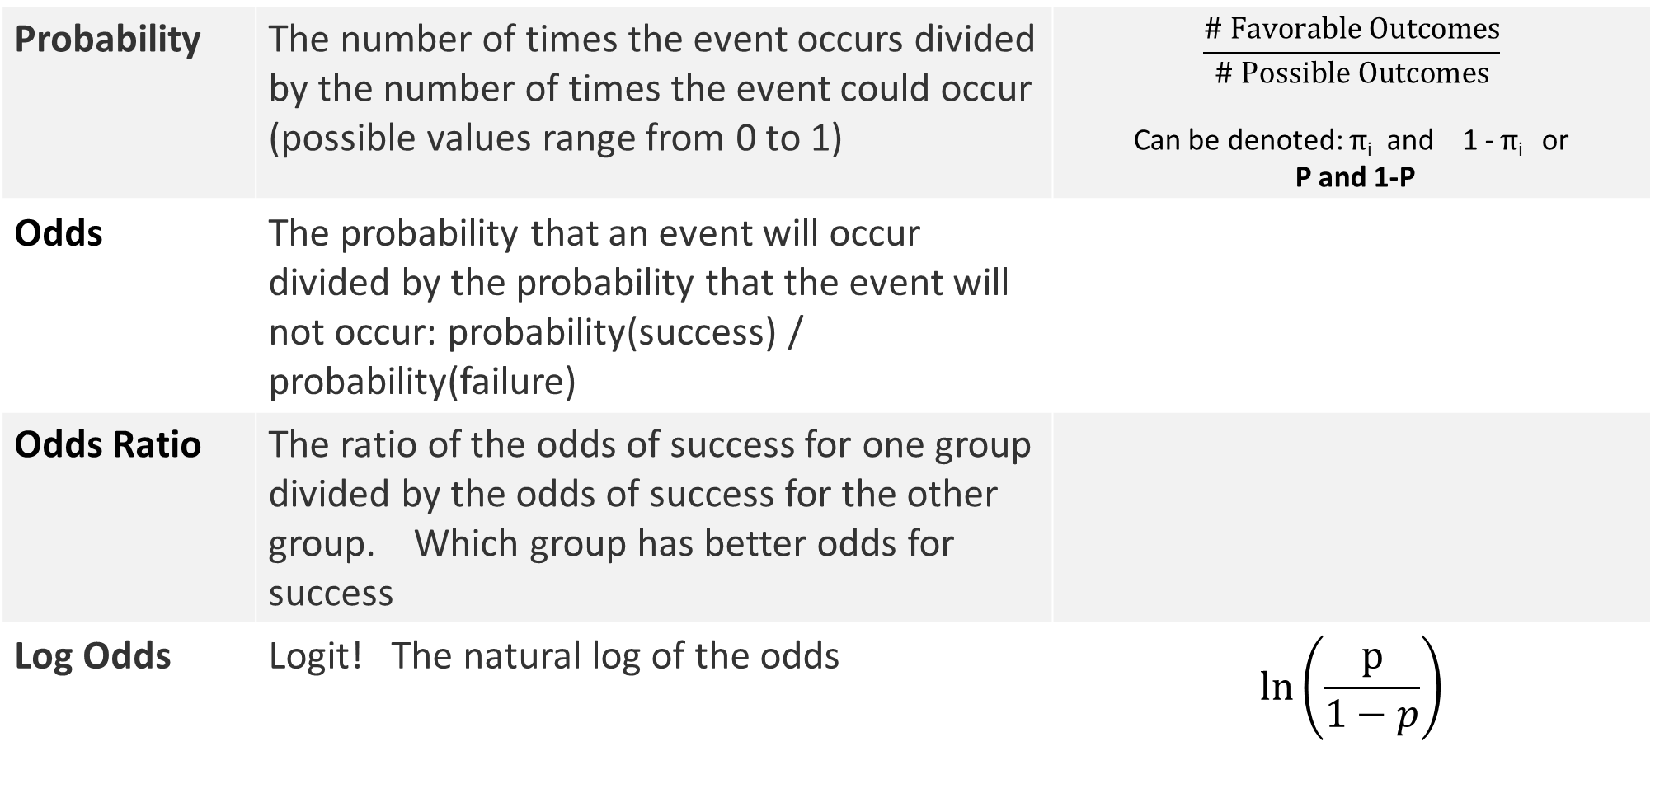

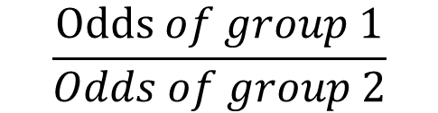

Probability, Odds, Odds Ratio and Log Odds
Probability | The number of times the event occurs divided by the number of times the event could occur (possible values range from 0 to 1) | $$\frac{\# Favorable Outcomes}{\# Possible Outcomes}$$ Can be denoted: $π$_{i} and 1 - $π$_{i} or P and 1-P
Odds | The probability that an event will occur divided by the probability that the event will not occur: probability(success) / probability(failure)
Odds Ratio | The ratio of the odds of success for one group divided by the odds of success for the other group. Which group has better odds for success
Log Odds | Logit! The natural log of the odds | $$\ln\left(\frac{p}{1−p}\right)$$
$$\frac{p}{1−p}$$
or
$$\frac{Odds of group 1}{Odds of group 2}$$
$$\frac{\frac{p}{1−p}}{\frac{p}{1−p}}$$

Slide 6


Log odds
Since $\hat{P}$has to be between 0 and 1, we need to look at the Log Odds
Logistic Regression equation:
$\text{ln}\left(\frac{\hat{P}}{1−\hat{P}}\right)= β0$+$β1x1\text{+} β2x2$ … $βnxn$
Estimated Log odds of the dependent variable are equal to a linear combination of independent variables and their coefficients

Slide 7
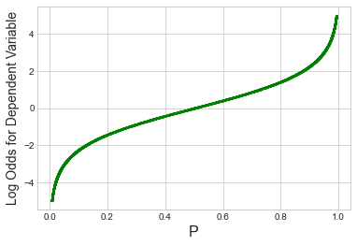
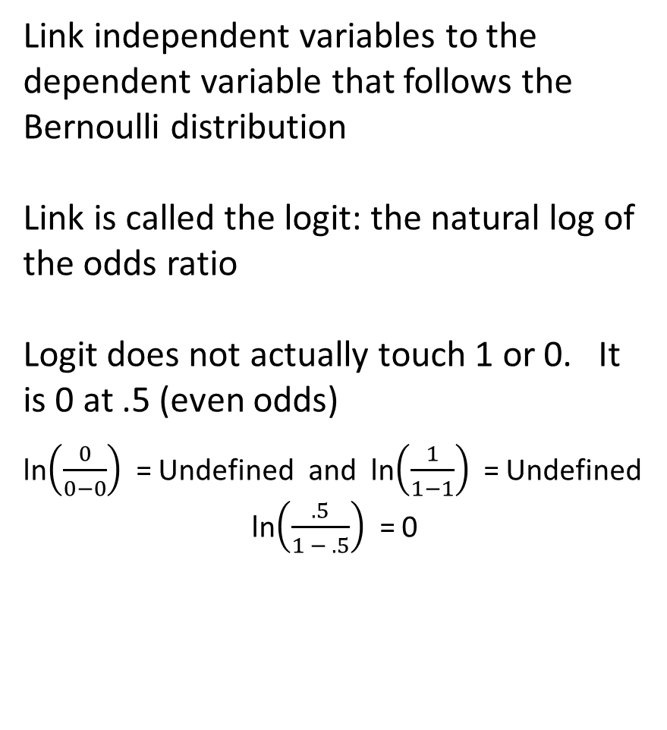
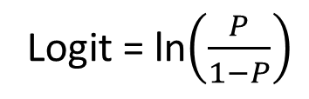
Logit or Log Odds
How do the odds of the dependent variable change with a 1 unit increase in an independent variable holding all other variables constant?
Link independent variables to the dependent variable that follows the Bernoulli distribution
Link is called the logit: the natural log of the odds ratio
Logit does not actually touch 1 or 0. It is 0 at .5 (even odds)
ln$\left(\frac{0}{0−0}\right)$ = Undefined and ln$\left(\frac{1}{1−1}\right)$ = Undefined
ln$\left(\frac{.5}{1 − .5}\right)$ = 0
Log odds
Logit = ln$\left(\frac{P}{1−P}\right)$

Slide 8

Logistic Function
We want probability P on the y axis
Taking an inverse of logit function. This is the Logistic Function
An Antilog is the reverse of a logarithm: raise a logarithm to its base
$\text{ln}\left(\frac{\hat{P}}{1−\hat{P}}\right)= β0$+$β1x1\text{+} β2x2$
P = $e^{β0 \text{+} β1x1\text{+} β2x2 }$ (1-P)
P= $e^{β0 \text{+} β1x1\text{+} β2x2 }$ - $e^{β0 \text{+} β1x1\text{+} β2x2}$ (P)
P+ $e^{β0 \text{+} β1x1\text{+} β2x2 }$ (P) = $e^{β0 \text{+} β1x1\text{+} β2x2 }$
$\hat{P}$ = $\frac{e^{β0 \text{+} β1x1\text{+} β2x2 }}{1+e^{β0 \text{+} β1x1\text{+} β2x2 }}$

Slide 9
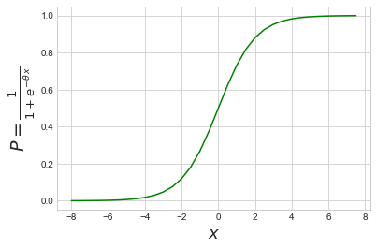
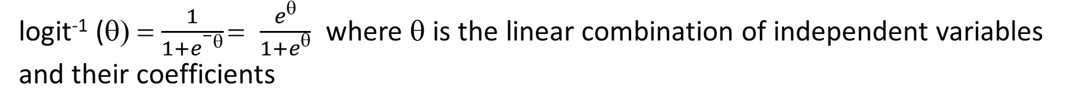
Logistic Function
logit⁻¹ (θ) = $\frac{1}{1+e−θ}$ = $\frac{eθ}{1+eθ}$ where θ is the linear combination of independent variables and their coefficients

Slide 10
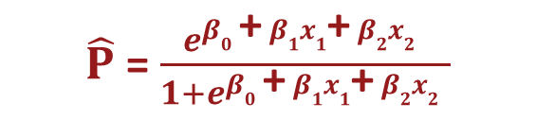
What do we do with this?
$\hat{P}$ = $\frac{e^{β0 \text{+} β1x1\text{+} β2x2 }}{1+e^{β0 \text{+} β1x1\text{+} β2x2 }}$
Our equation:
Take values of coefficients and plug in for Betas
Plug in the variable values for X that we want to use for prediction
Get the estimated probability from the equation.

Slide 11
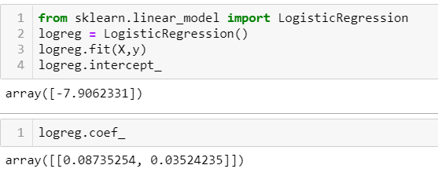
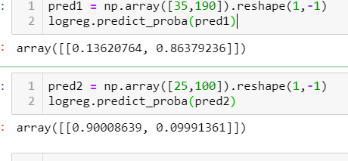

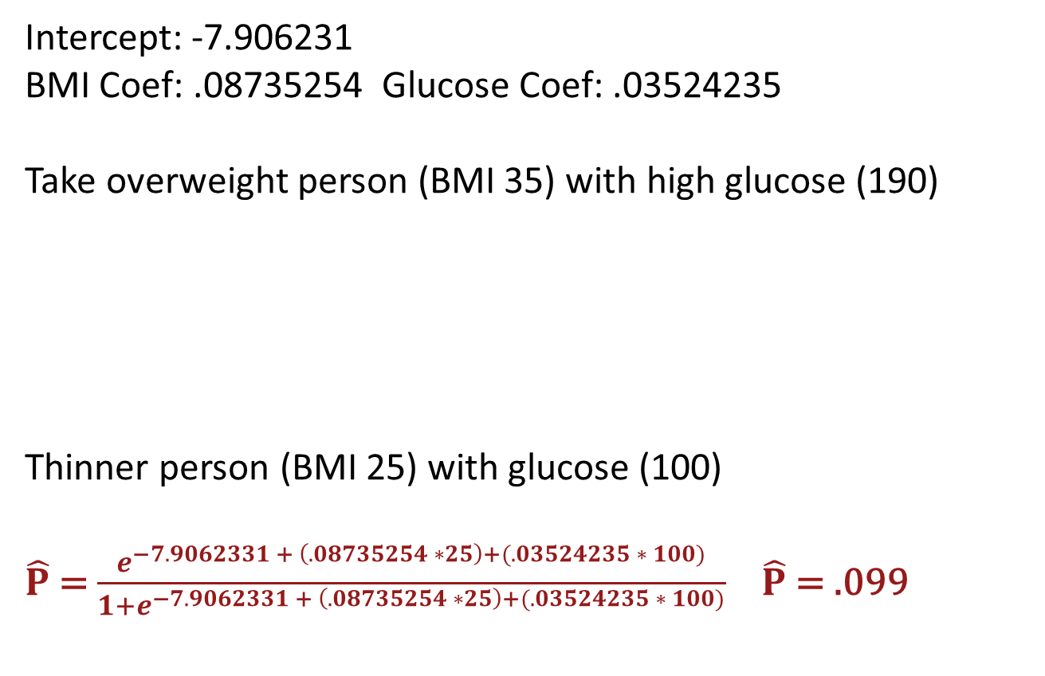

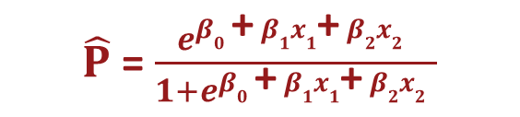
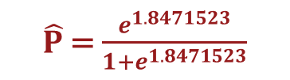
An example for fun
$\hat{P}$ = $\frac{e^{β0 \text{+} β1x1\text{+} β2x2 }}{1+e^{β0 \text{+} β1x1\text{+} β2x2 }}$
Our equation:
Coefficients from Sklearn:
Intercept: -7.906231
BMI Coef: .08735254 Glucose Coef: .03524235
Take overweight person (BMI 35) with high glucose (190)
Thinner person (BMI 25) with glucose (100)
$\hat{P}$ = $\frac{e^{−7.9062331 + \left(.08735254 ∗25\right)+(.03524235 ∗ 100)}}{1{+e}^{−7.9062331 + \left(.08735254 ∗25\right)+(.03524235 ∗ 100)}}$ $\hat{P}$ = .099
$\hat{P}$ = $\frac{e^{−7.9062331 + \left(.08735254 ∗ 35\right)+(.03524235 ∗ 190)}}{1{+e}^{−7.9062331 + \left(.08735254 ∗ 35\right)+(.03524235 ∗ 190)}}$
Just to check my hand calculation!
$\hat{P}$ = $\frac{e^{1.8471523}}{1{+e}^{1.8471523}}$
$\hat{P}$ = $\frac{6.3417}{7.3417}$
$\hat{P}$ = .863

Slide 12
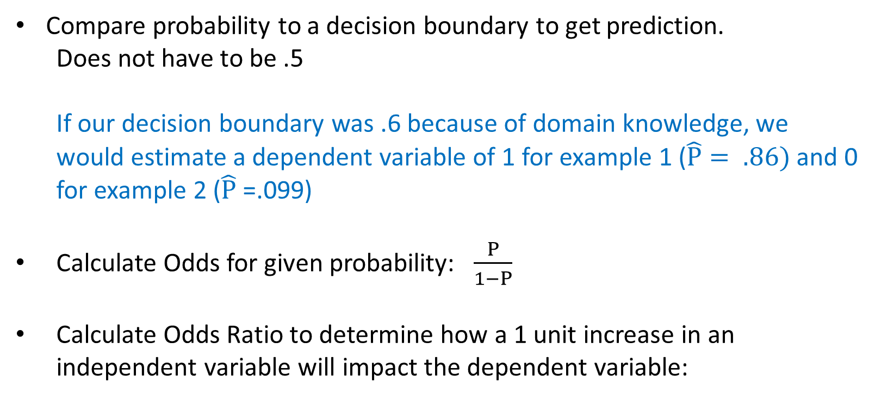
More we can do
Compare probability to a decision boundary to get prediction.
Does not have to be .5
If our decision boundary was .6 because of domain knowledge, we would estimate a dependent variable of 1 for example 1 ($\hat{P}= .86)$ and 0 for example 2 ($\hat{P}$ =.099)
Calculate Odds for given probability: $\frac{P}{1−P}$
Calculate Odds Ratio to determine how a 1 unit increase in an independent variable will impact the dependent variable:

Slide 13
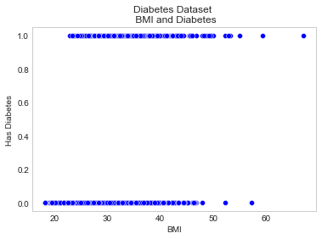
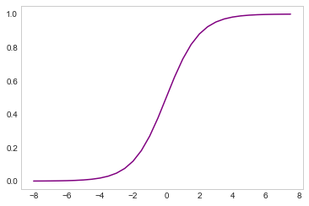
Summary so far
Link independent variables to the dependent variable that follows the Bernoulli distribution and get the log odds for the dependent variable
Take the inverse of the logit function and get the logistic function so we can get the probability of the event given the independent variables
But how did we get the coefficients for the independent variables?

Slide 14

Maximum Likelihood Estimation
Goal is to choose values for the coefficients for the independent variables
Use Maximum Likelihood Estimation (MLE) to accomplish this.
Recall our equation:
θ (theta) will be the vector of coefficients of the independent variables. Goal is to learn the values of these coefficients. We are going to calculate the dot product of the vector of coefficients (matrix transpose) and the values of the independent variables where X₀ will be set to 1. This will be a weighted sum of the components of the independent variables.
Will need to actually maximize the Log likelihood for Logistic Regression
$\text{ln}\left(\frac{\hat{P}}{1−\hat{P}}\right)= β0$+$β1x1\text{+} β2x2$ … $βnxn$
P( Y=1 | X=x) = σ(θ^{T}x)

Slide 15
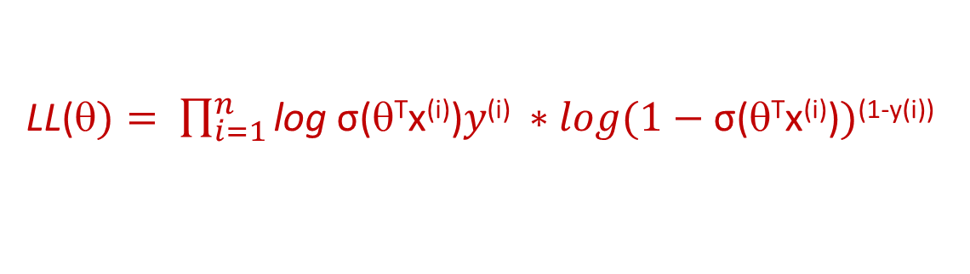
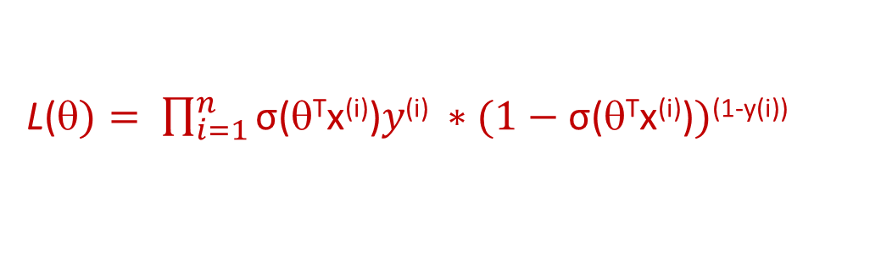
Maximum Likelihood Estimation
Likelihood of coefficients is sum of probability
Dependent variable follows Bernoulli distribution
For Logistic Regression, take log of the Likelihood
L(θ$)= \prod_{i=1}^{n}{P\left(Y=y\left(i\right)\right)| X=x\left(i\right))}$
L(θ$)= \prod_{i=1}^{n}{\text{σ}\text{(}\text{θ}\text{T}\text{x}\text{(}\text{i}\text{)}\text{)}y\text{(}\text{i}\text{)} ∗(1−\text{σ}\text{(}\text{θ}\text{T}\text{x}\text{(}\text{i}\text{)}\text{)})\text{(}\text{1−}\text{y}\text{(}\text{i}\text{)}\text{)}}$
LL(θ$)= \prod_{i=1}^{n}{\text{log} \text{σ}\text{(}\text{θ}\text{T}\text{x}\text{(}\text{i}\text{)}\text{)}y\text{(}\text{i}\text{)} ∗log(1−\text{σ}\text{(}\text{θ}\text{T}\text{x}\text{(}\text{i}\text{)}\text{)})\text{(}\text{1−}\text{y}\text{(}\text{i}\text{)}\text{)}}$

Slide 16
Maximum Likelihood Estimation
Choose the values of θ that maximize the likelihood using an optimization algorithm
Use gradient ascent to maximize the likelihood. Which will continuously take small steps to get to a maximum likelihoood value. Would be impossible "by hand".
Basically store the old values, take a new step and check that the new value is better.
θi $New\text{ = }\text{}\text{i} Old+step ∂∗\frac{∂LL(\text{}old)}{∂\text{}\text{i}old)} \prod_{i=1}^{n}{\text{log} \text{σ}\text{(}\text{}\text{T}\text{x}\text{(}\text{i}\text{)}\text{)}y\text{(}\text{i}\text{)} ∗log(1−\text{σ}\text{(}\text{}\text{T}\text{x}\text{(}\text{i}\text{)}\text{)})\text{(}\text{1−}\text{y}\text{(}\text{i}\text{)}\text{)}}$

Slide 17
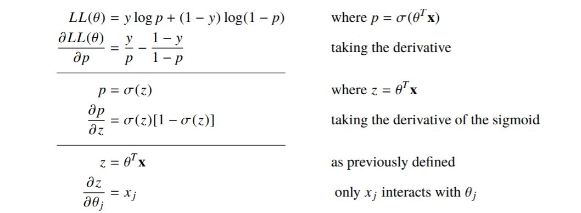
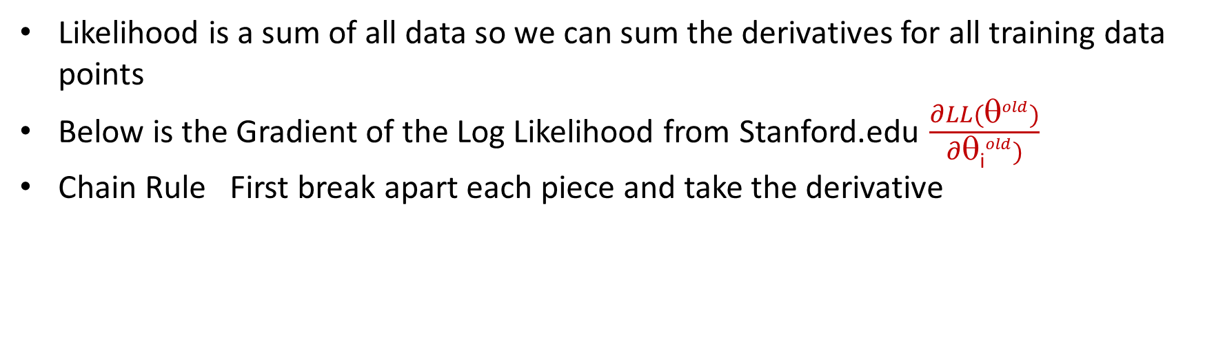
Derivative of Gradient
Likelihood is a sum of all data so we can sum the derivatives for all training data points
Below is the Gradient of the Log Likelihood from Stanford.edu $\frac{∂LL(\text{θ}old)}{∂\text{θ}\text{i}old)}$
Chain Rule First break apart each piece and take the derivative
Monroe, Will (August 14, 2017) Logistic Regression Lecture Notes #22
https://web.stanford.edu/class/archive/cs/cs109/cs109.1178/lectureHandouts/220-logistic-regression.pdf

Slide 18
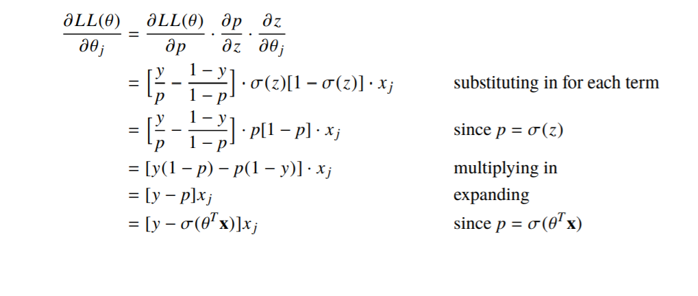
Derivative of Gradient
Continued with Chain Rule of Derivatives. Multiply pieces back together
Monroe, Will (August 14, 2017) Logistic Regression Lecture Notes #22
https://web.stanford.edu/class/archive/cs/cs109/cs109.1178/lectureHandouts/220-logistic-regression.pdf

Slide 19
Summary
Link independent variables to the dependent variable that follows the Bernoulli distribution and get the log odds for the dependent variable
Take the inverse of the logit function and get the logistic function so we can get the probability of the event given the independent variables
Calculate the coefficients maximum Log Likelihood via gradient ascent using training data points
Get our Logistic regression equation.
Input our independent variables and predict the probability of the dependent variable.

Slide 20
References
Monroe, Will (August 14, 2017) Logistic Regression Lecture Notes #22
https://web.stanford.edu/class/archive/cs/cs109/cs109.1178/lectureHandouts/220-logistic-regression.pdf
Bhattacharyya, Saptashwa (2018) " 'Logit of Logistical Regression; Understanding the Fundamentals“
https://towardsdatascience.com/logit-of-logistic-regression-understanding-the-fundamentals-f384152a33d1
G. Rodr´ıguez (2007) “Logit Models for Binary Data”
https://data.princeton.edu/wws509/notes/c3.pdf
Folz, Brandon (2015) “Statistics 101: Logistic Regression, Estimating the Probability”
https://www.youtube.com/watch?v=gcr3qy0SdGQ
Ramsey, Fred and Schafer, Daniel (2018) “The Statistical Sleuth” print
Scikit-learn: Machine Learning in Python, Pedregosa et al., JMLR 12, pp. 2825-2830, 2011.
https://www.kaggle.com/mathchi/diabetes-data-set

